Slide 1

Enhancing Seismic Safety in Munich's Geothermal Energy Sector: Data-driven Model Updating for Building Vibrations under Induced Seismicity
M.Sc. Wei-Teng, Kao
Technical University of Munich
TUM School of Engineering and Design
Chair of Structural Mechanics
Munich, 23.09.2024

Slide 2
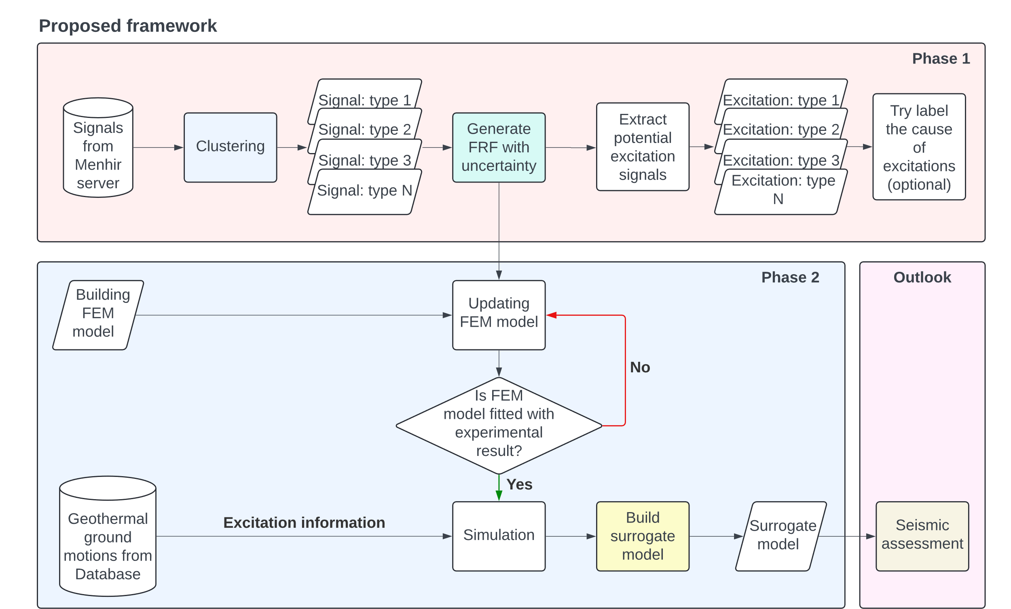
Proposed framework of the MDSI project
Current focusing part

Slide 3
System identification during operation
Two different system identification methods are used, which are SSI-COV and Single Sensor Identification (SSI).
Practically, SSI-COV could provide us with more accurate results than the SSI method. However, SSI-COV requires multiple channel measurements.
SSI might be too sensitive since it is based on frequency domain decomposition (FDD), which ideally used for multiple-output problem
In our case, we have only one sensor( geophone) on each floor, which is practically not enough for operational modal analysis (OMA)
SSI-COV method is quite sensitive to parameters, different setups of parameters might lead to different results

Slide 4
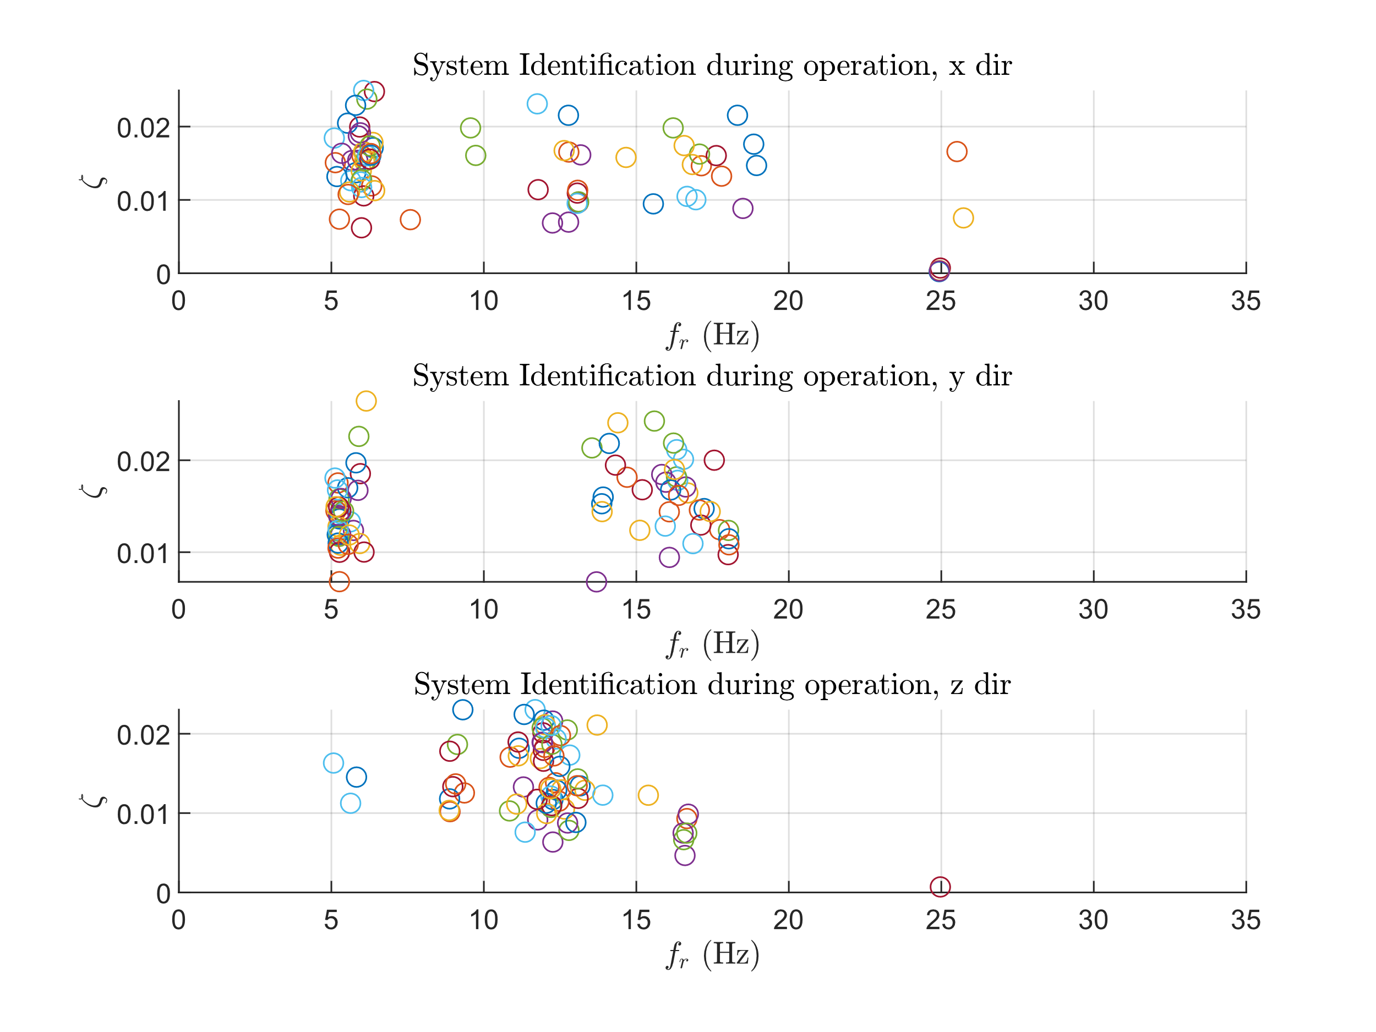
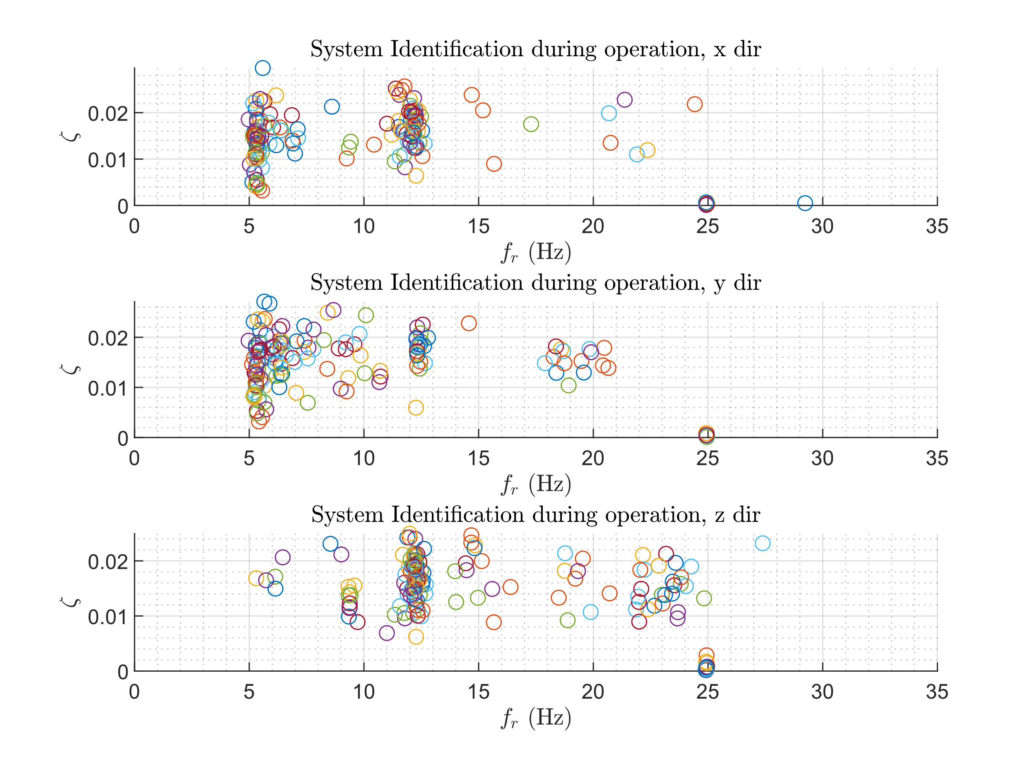
System identification using SSI from 75 events
Detected dominated frequency against damping ratio, 1OG
Detected dominated frequency against damping ratio, 2OG
* System identification using SSI methods. Two modes are collected for each event, where only the events that both sensors in 1OG and 2OG are activated simultaneously will be counted, the number of events is N = 75.

Slide 5
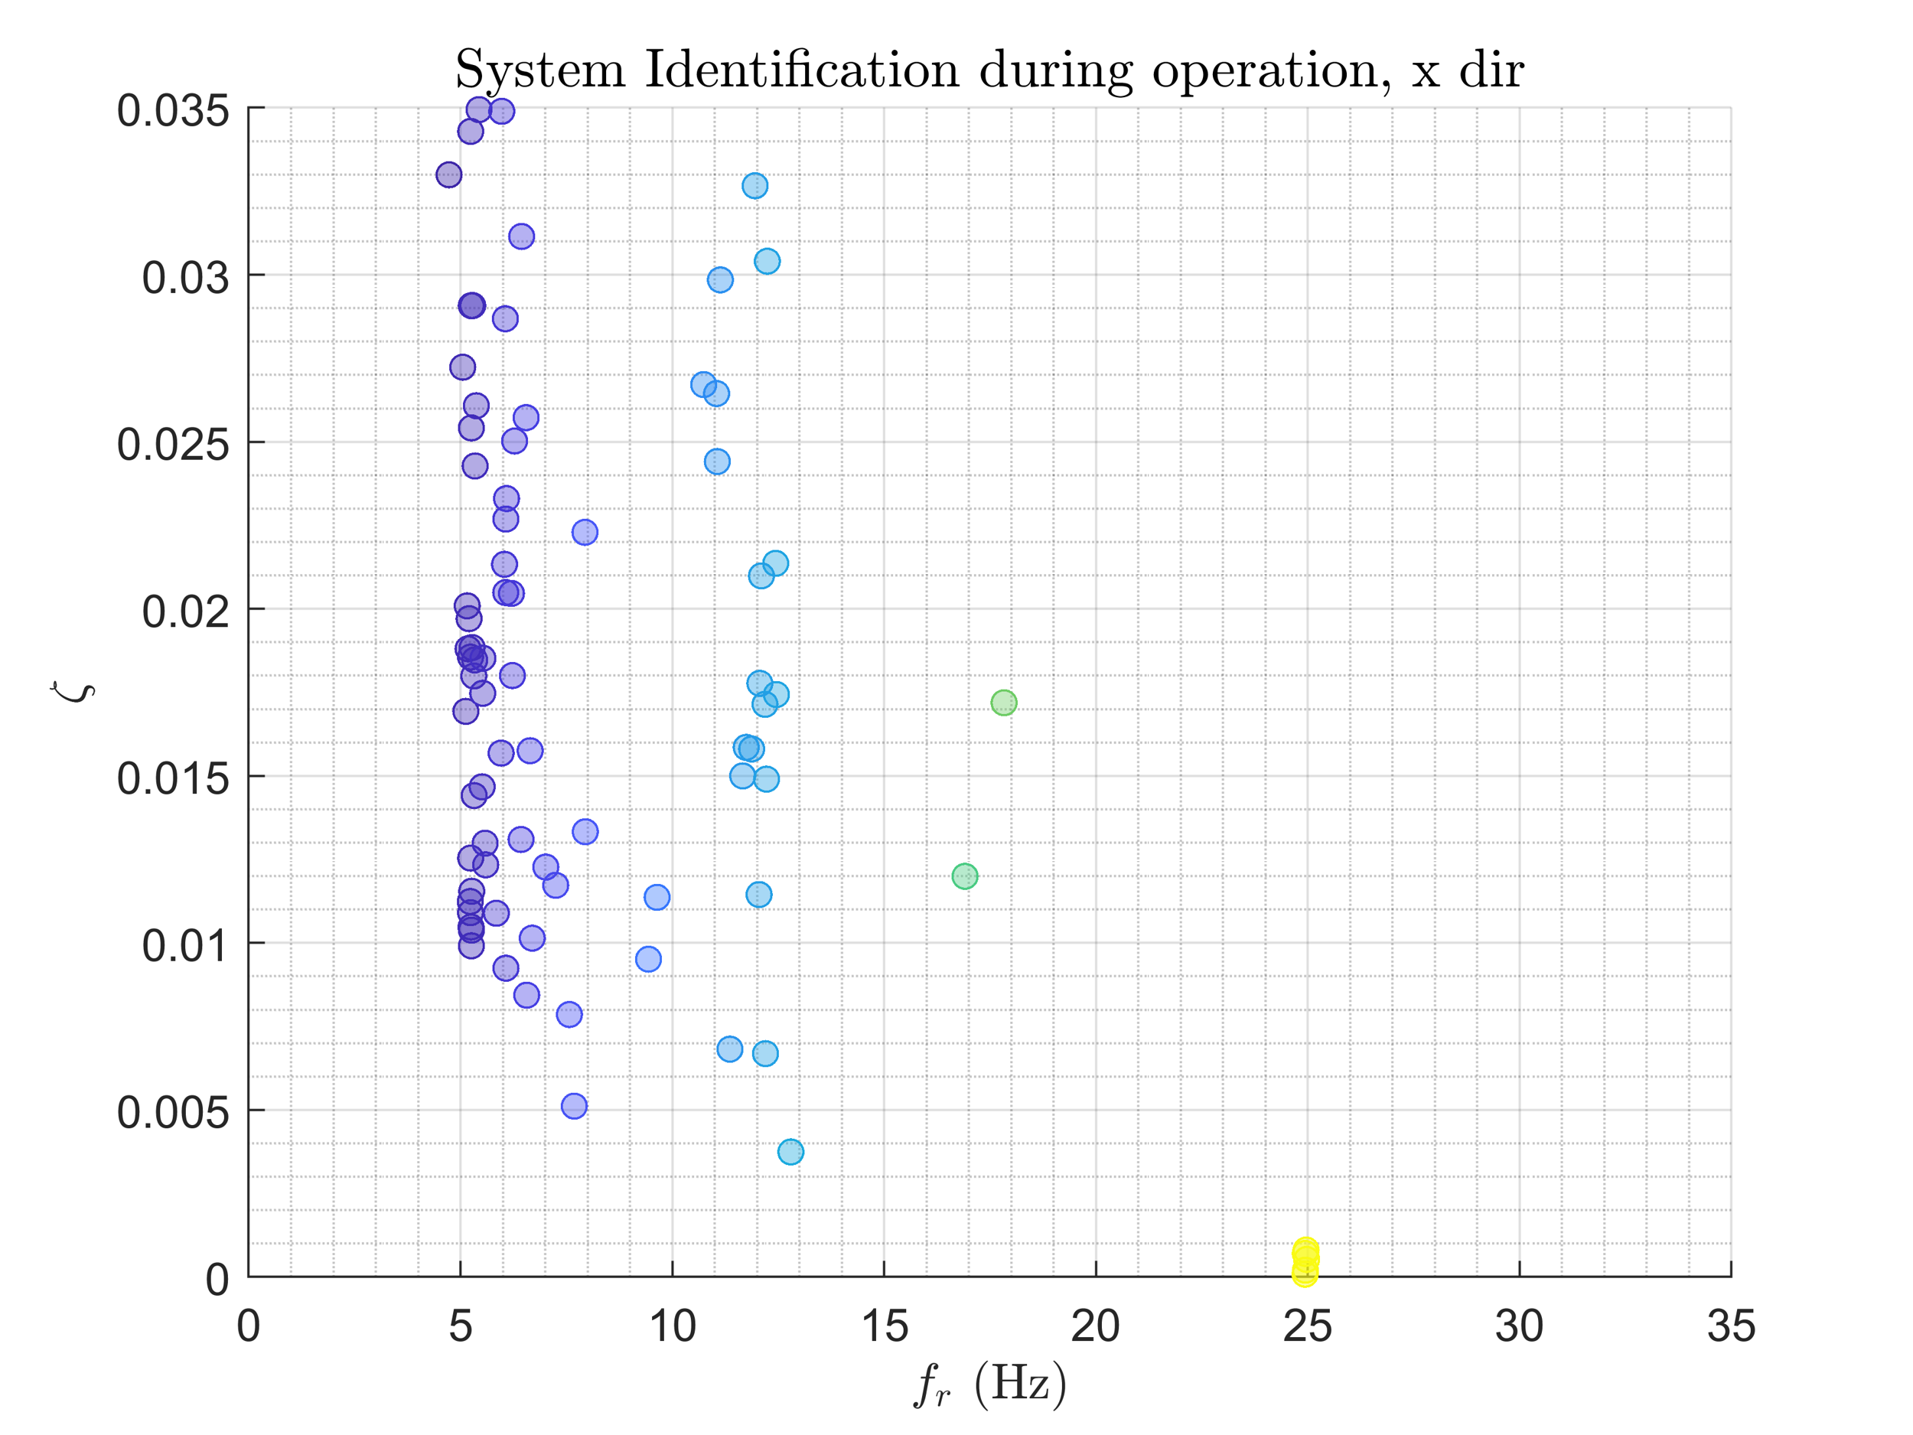
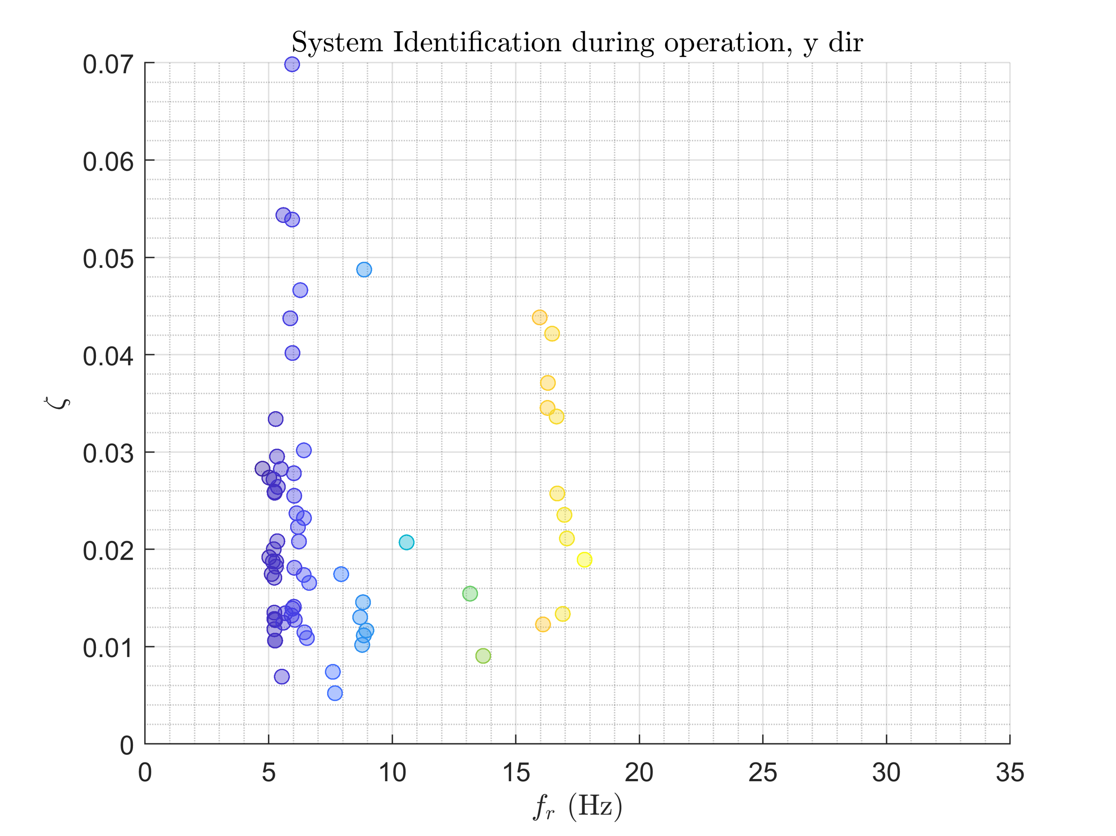
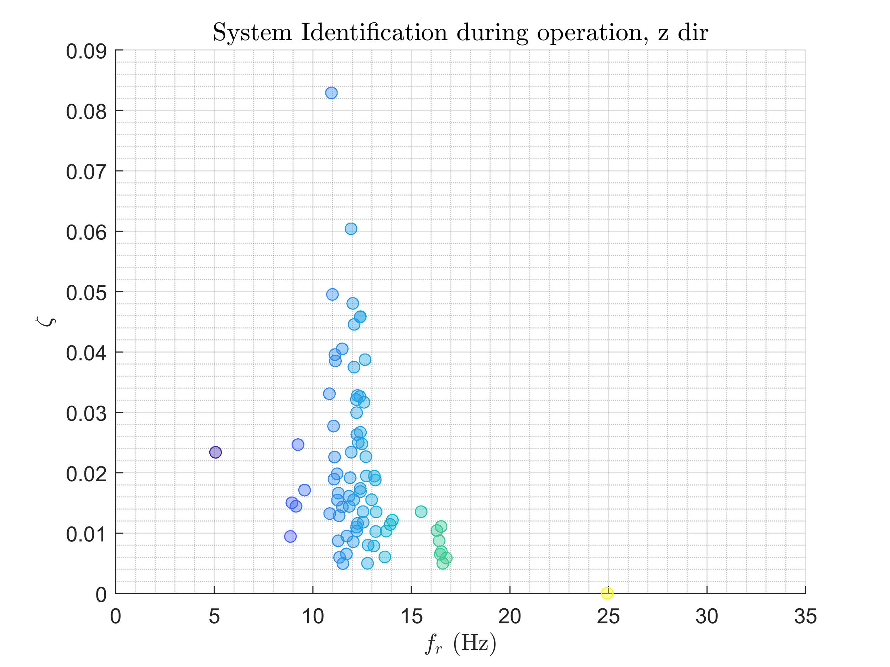
System identification using SSI-COV from 75 events
Detected system in x dir.
Detected system in y dir.
Detected system in z dir.
* System identification using SSI-COV methods. A number of modes are automatically detected for each event, where only the events that both sensors in 1OG and 2OG are activated simultaneously will be counted; the number of events is N = 75.

Slide 6
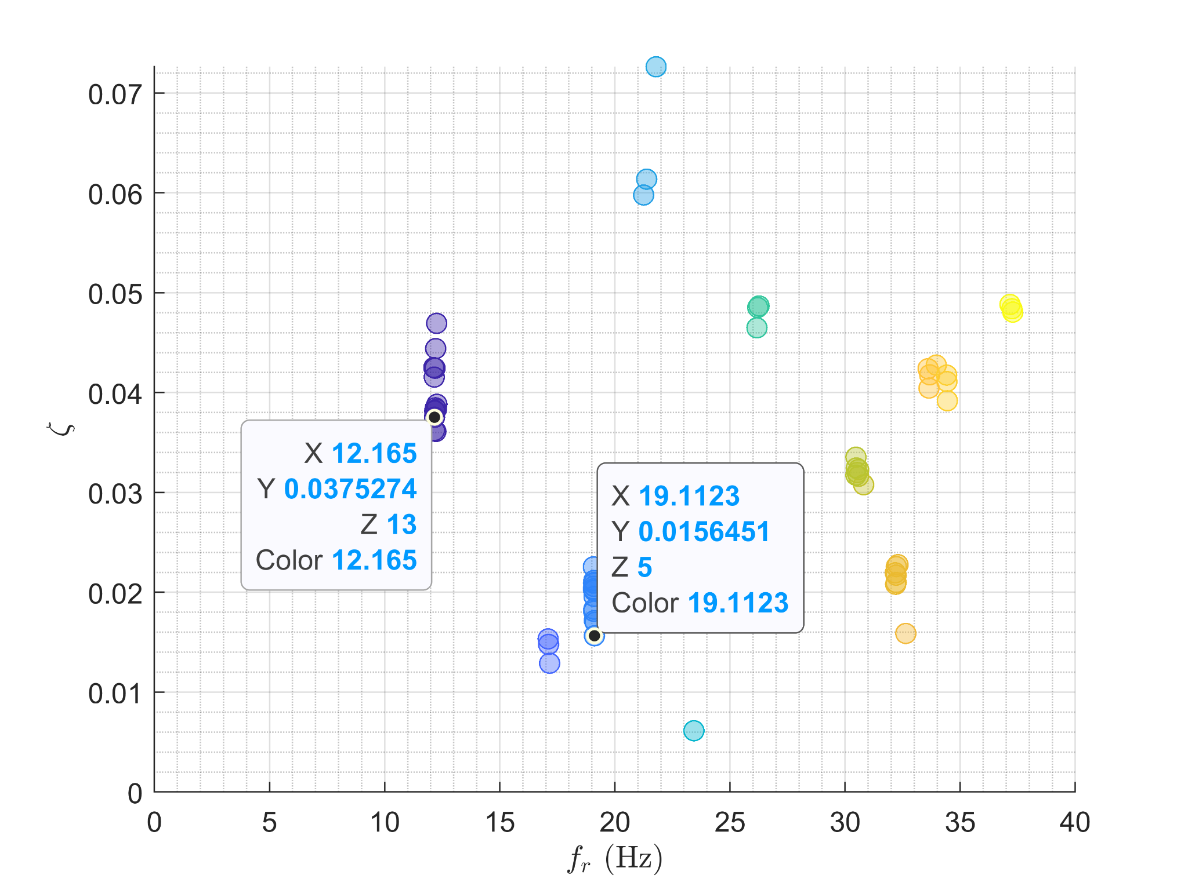
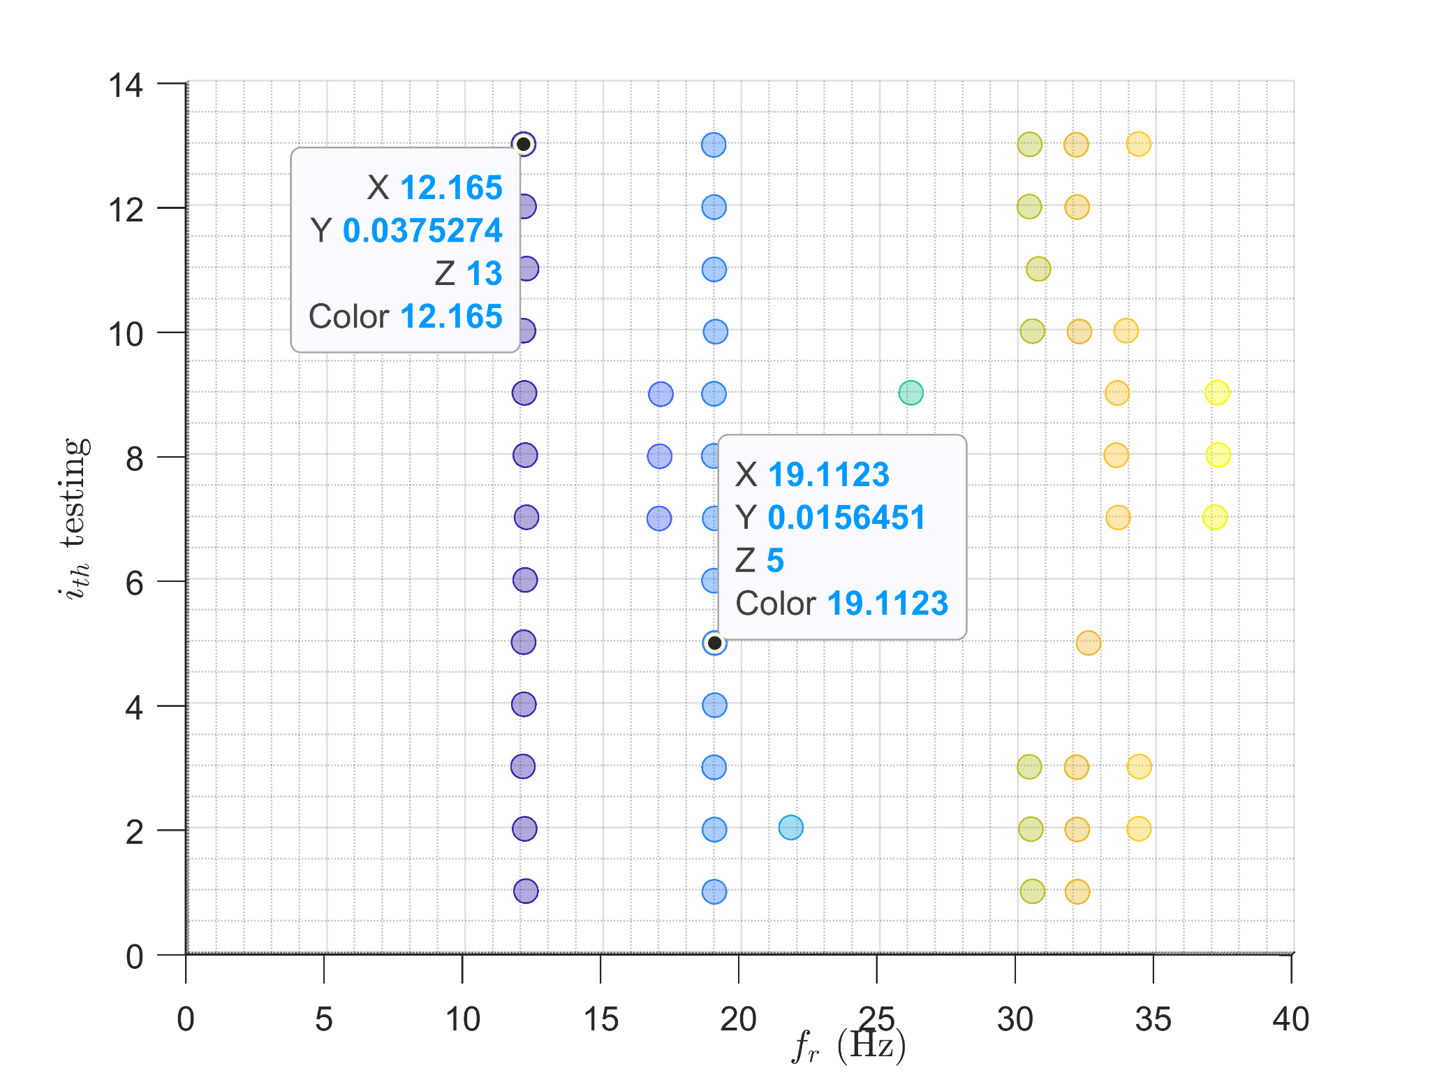
System identification using SSI-COV from 13 hammer testing in z-dir
Detected system in z dir.
We Have 13 testing case, which can be separated to 3 events (different event means same signal recording locations but different excitation location ) from the RHS figure, case 1 - 6 are from event EX220 , case 7 - 9 from event EX221, case 10-13 are from event EX22.

Slide 7
System identification by hammer testing
Hammer testing belongs to the Experimental Modal Analysis (EMA) method, which could provide us with more accurate results than OMA.
In our experiment, four accelerometers are installed at each floor slab and three on the wall; I only focus on the accelerometers installed at each floor slab, which total 8 accelerometers.
The signal received from the sensor on the wall is relatively small compared to the signal received from the sensor on the slab. Therefore, I ignored them in my analysis.
The Location of measurement and excitation will be reported in the next slide.
Since the simulation will return the displacement signal, I transfer the experiment data from acceleration to displacement.

Slide 8
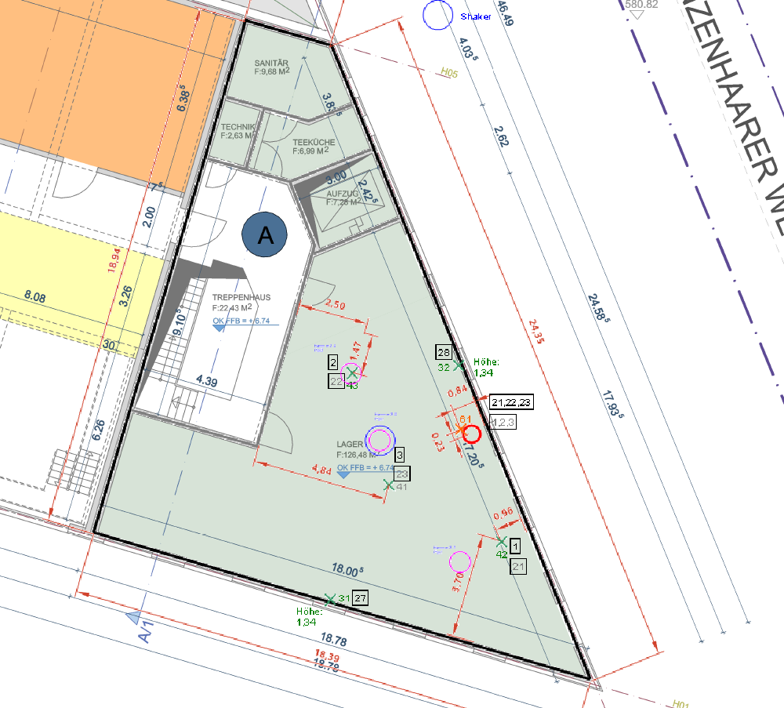
Hammer testing: excitation points
Coordinates of Excitation points:
Position 1 (ID: EX22) : [9.30, 5.90, Z]
Position 2 (ID: EX221) : [12.77, 2.748, Z]
Position 3 (ID: EX220) : [7.19 , 8.14, Z]
More than three tests are applied on each excitation point.
The Z in coordinates indicates the height of the second floor, which is one of the parameters that will be updated.
Y
X

Slide 9
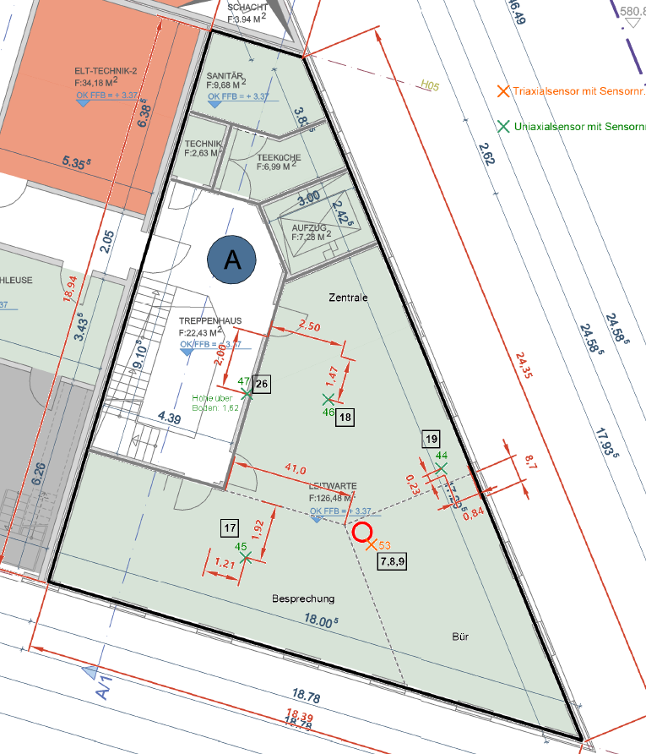
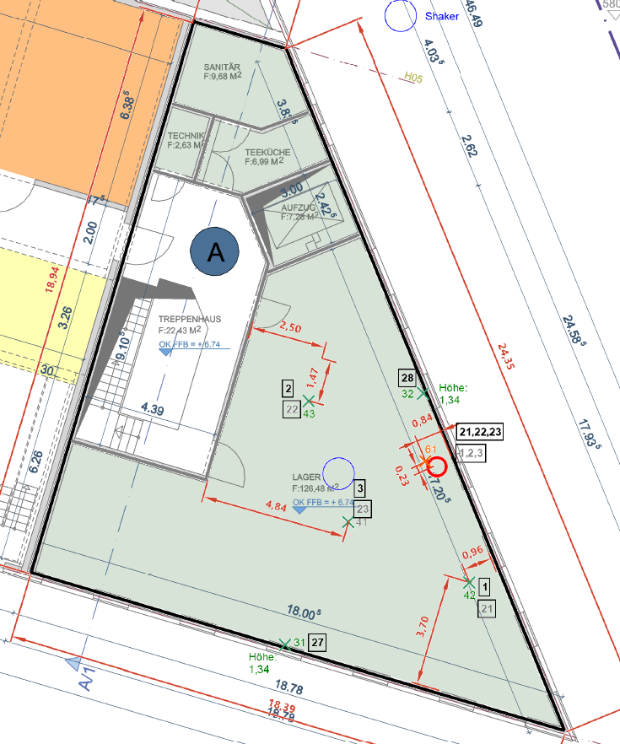
Hammer testing: measurement points
Uniaxial
Triaxial
Y
11
Y
14
Geophone
12
15
10
9
3
13
X
X

Slide 10
System identification by hammer testing, location 1 (ID: EX22)
*The ID in the label indicates the ID of the channel. On the first floor, the channels are 9,10,11,12, and on the second floor, it is 3,13,14,15
* Here, only plot the imaginary part of the FRF since the imaginary part can be used to detect the mode shape

Slide 11
System identification by hammer testing, location 2 (ID: EX221)
*The ID in the label indicates the ID of the channel. On the first floor, the channels are 9,10,11,12, and on the second floor, it is 3,13,14,15
* Here, only plot the imaginary part of the FRF since the imaginary part can be used to detect the mode shape

Slide 12
System identification by hammer testing, location 3 (ID: EX220)
*The ID in the label indicates the ID of the channel. On the first floor, the channels are 9,10,11,12, and on the second floor, it is 3,13,14,15
* Here, only plot the imaginary part of the FRF since the imaginary part can be used to detect the mode shape

Slide 13
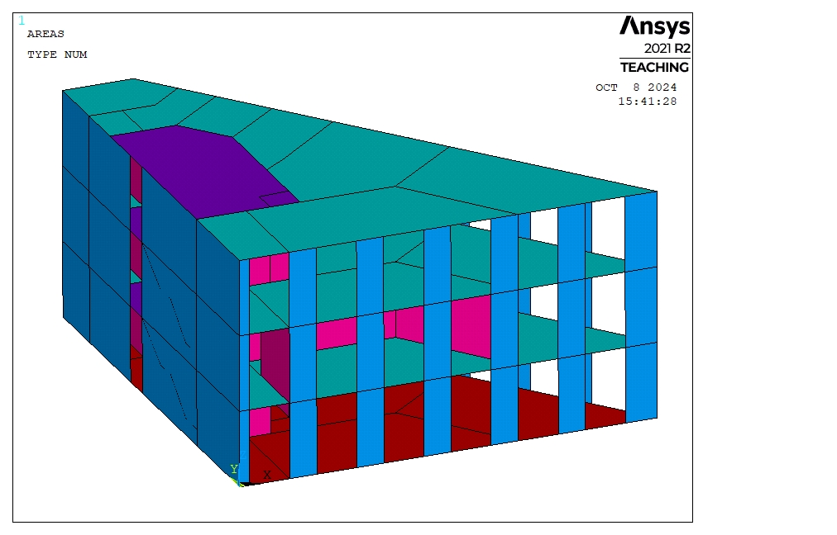
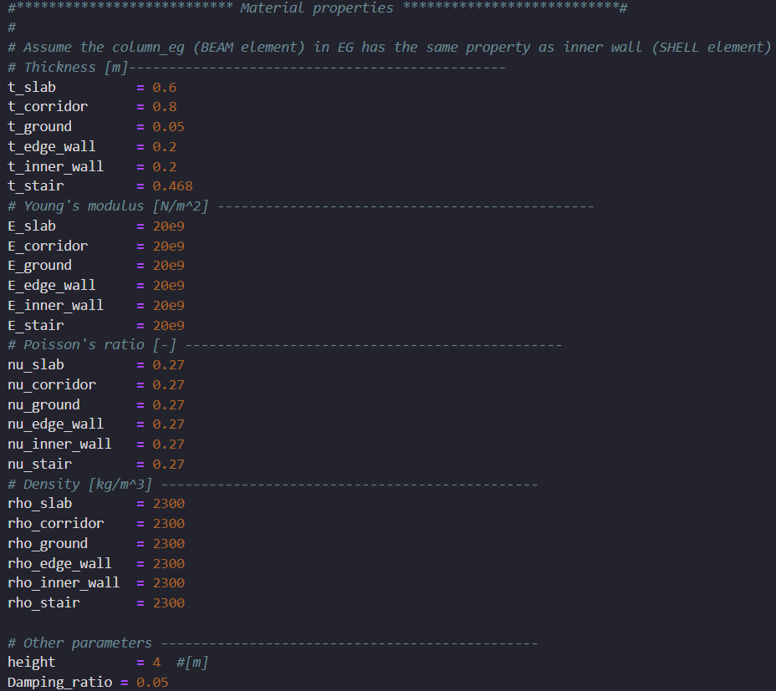
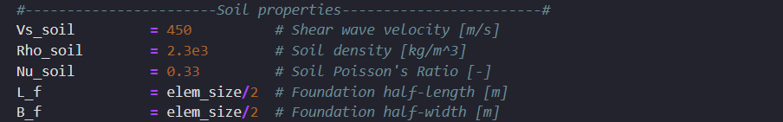
ANSYS model in python
Building parameter, N = 26
SSI parameter, N = 3

Slide 14
Harmonic analysis
For each parameter setups from DOE, three harmonic analysis are performed based on three different excitation points.
To mimic the hammer testing, the unit force load on z direction will be inputted.
The frequency response functions (FRFs) extracted from 8 measurement points will be compared with FRFs from hammer test for FEM update.
Using the Mode superposition (MSUP) method to accelerate the simulation. Compared to FULL method, it can approximately accelerate the simulation by 2X.
Two different cases are tested, one with Soil structure interaction, another one without.
mapdl.f(excitation_node,"FX",0)
mapdl.f(excitation_node,"FY",0)
mapdl.f(excitation_node,"FZ",1)

Slide 15
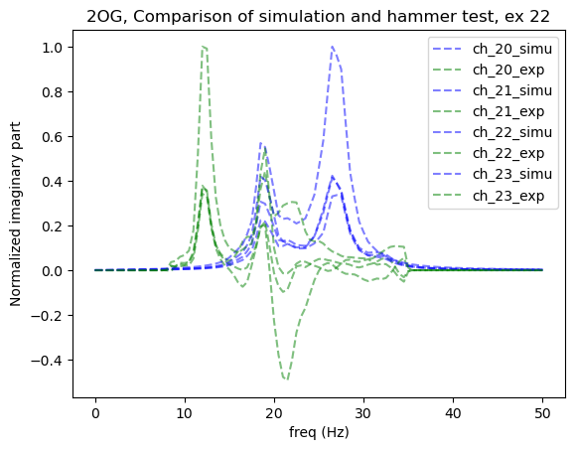
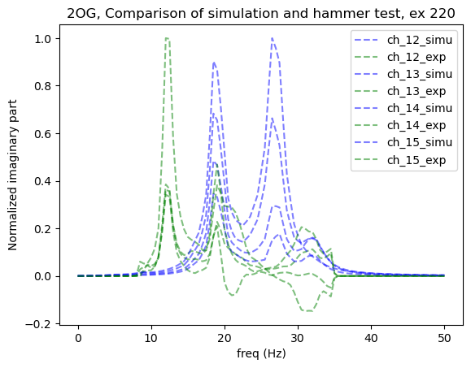
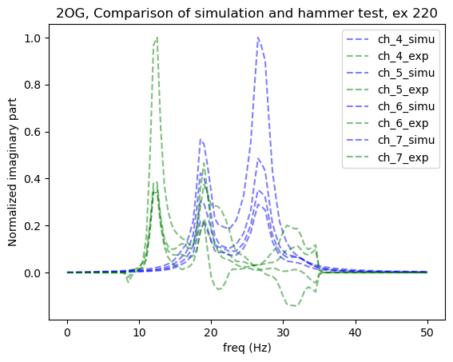
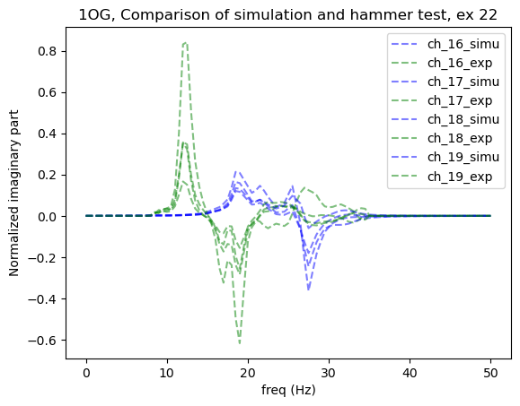
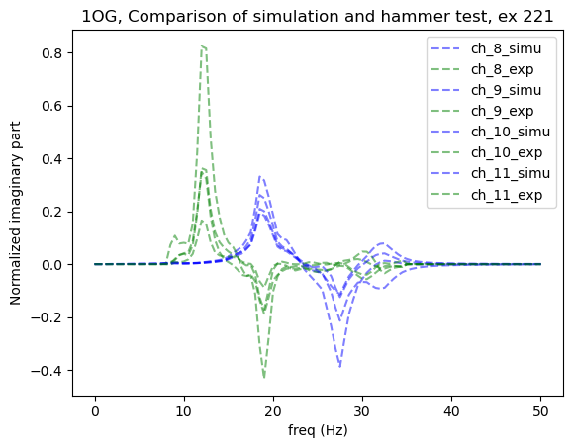
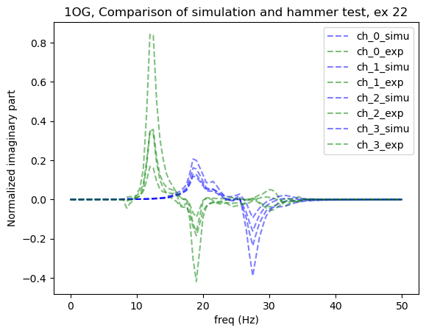
FRFs from initial guess parameter sets, x=np.zeros(19,1)

Slide 16
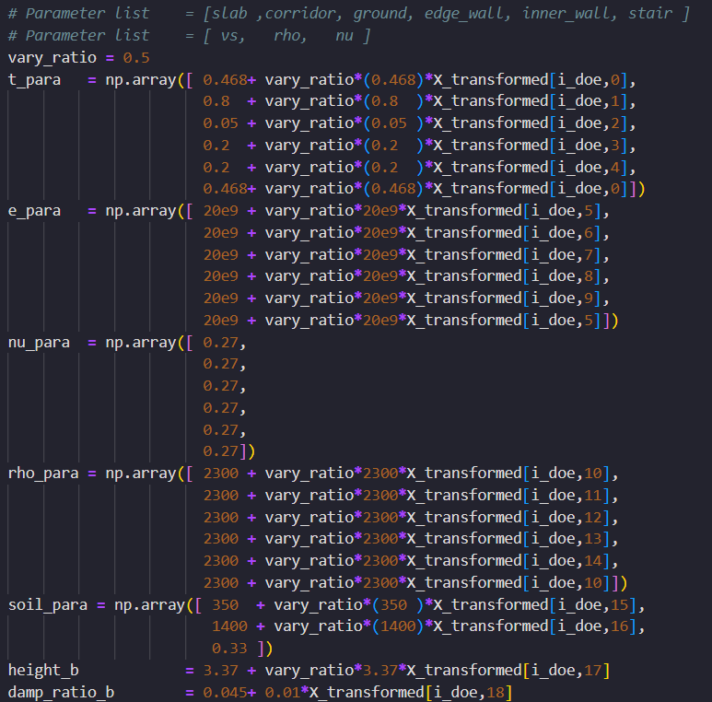
DOE and the range of parameter varying.
Using LHS for sampling
Assuming that there are 19 parameters need to be updated and the Poisson's ratios are fixed
Size of DOE, N = 1000
Assume the Vary_ratio = 0.5
X_transformed follows uniform distribution and in the range of [-1,1]

Slide 17
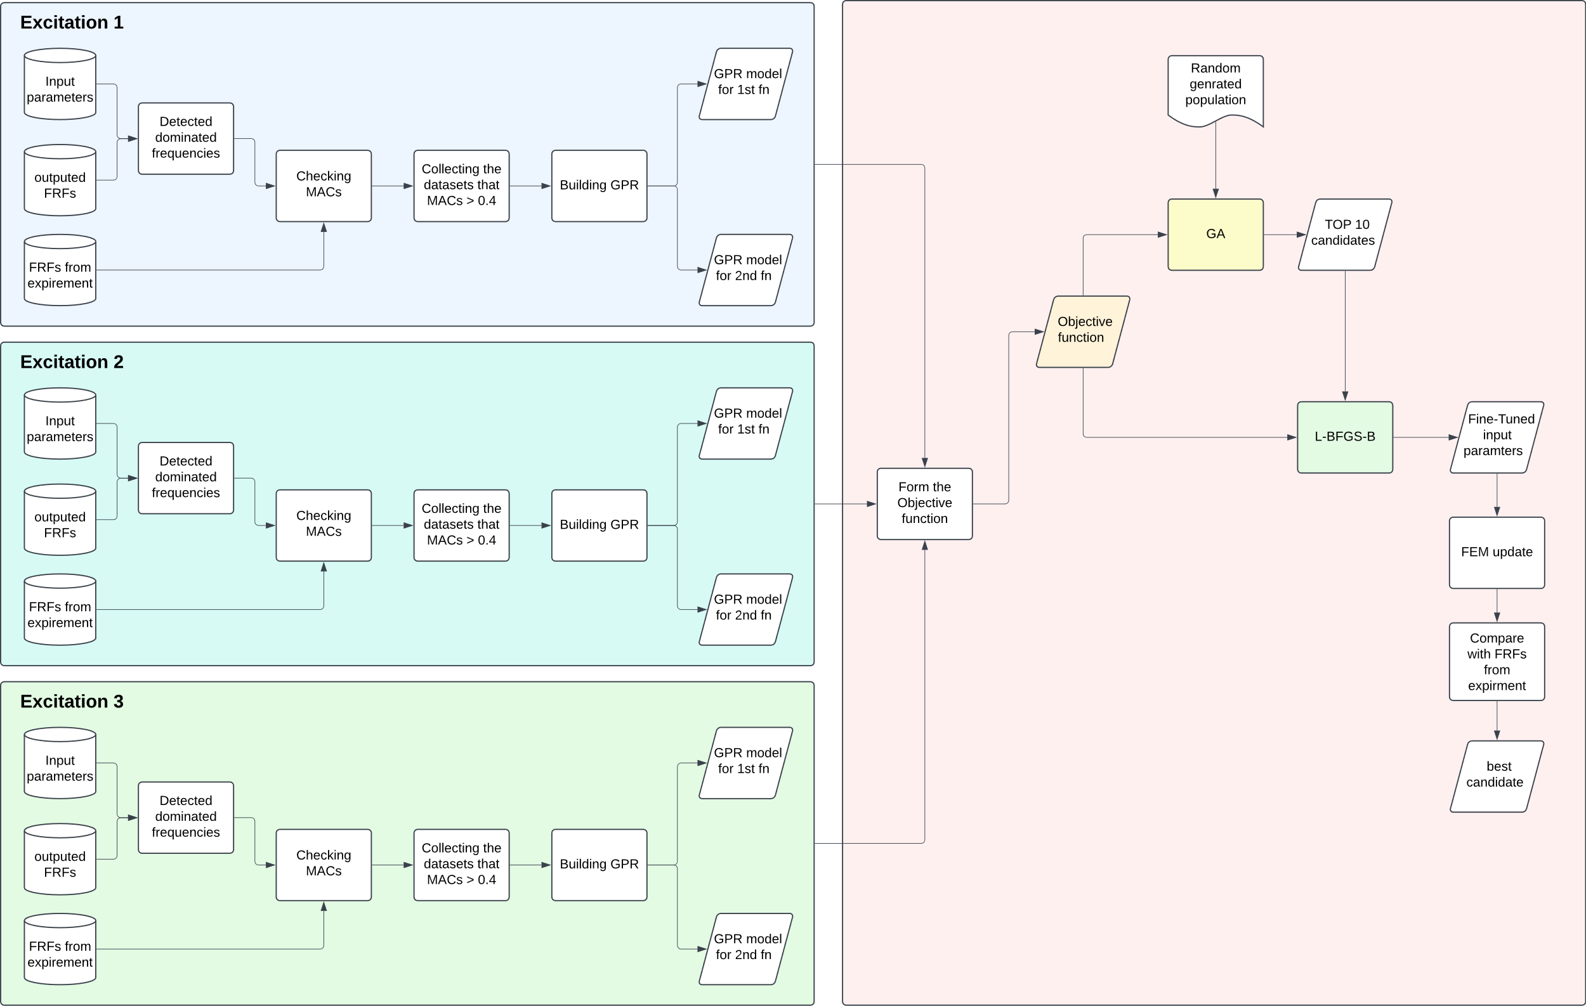
FEM update proposal

Slide 18
Selecting qualified datasets from further training and testing.
Only focus on the top two dominated frequencies, which are approximately 12 Hz and 18.5 Hz, according to FRFs from the hammer test.
According to the imaginary part of the FRFs, we can observe that mode shapes at 12 Hz are all in the same direction for both floors; However, the mode shape at 18 Hz shows the opposite for each floor; this will be a crucial indicator for detecting the correct mode shape from the simulation.
Using MAC to check the similarity of mode shape from testing and simulation.
For each simulation, If the MAC of each dominated frequency is less than 0.4, then it will be ignored. This is because some combination of the parameter sets might lead to peak overlapping, which will decrease the quality of collected training data.

Slide 19
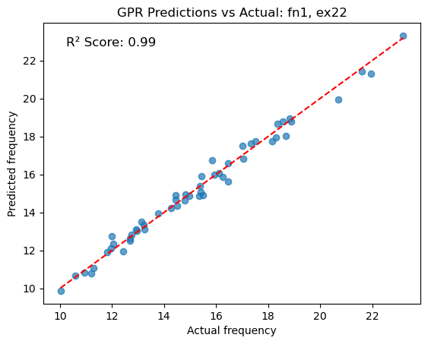
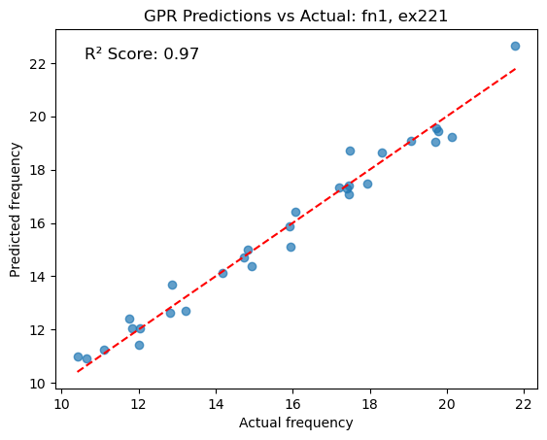
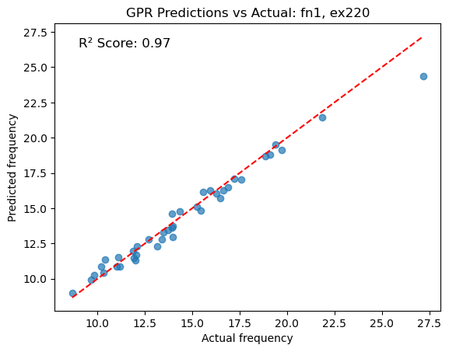
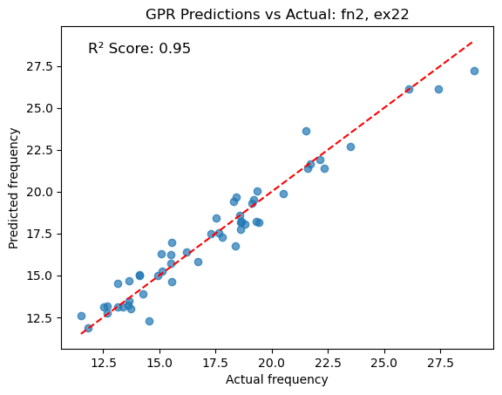
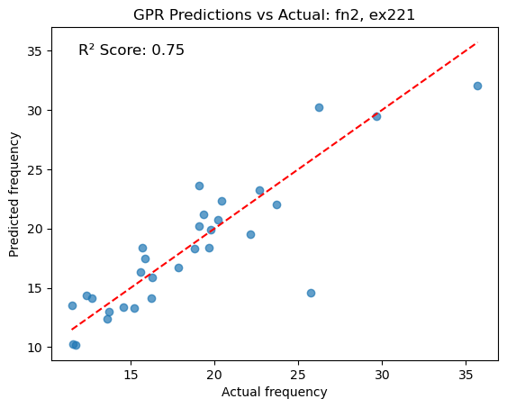
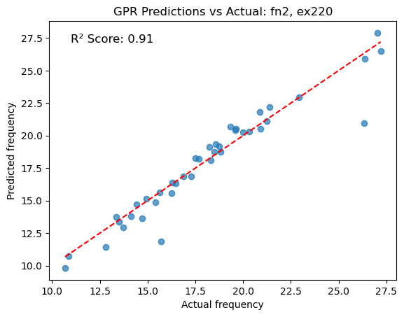
Surrogate model accuracy for each dominated frequency

Slide 20
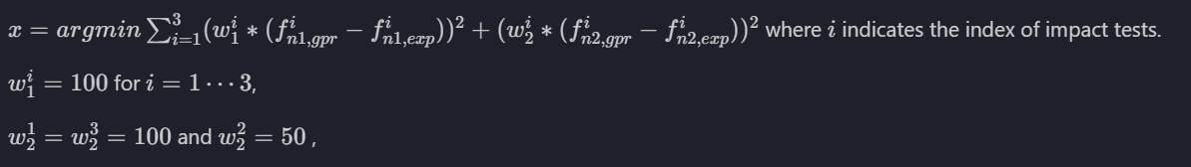
Forming the objective function:
Using LHS for sampling the population of GA.
Used GA as a “Warm start”; the top 10 candidates are extracted, followed by fine-tuning using the L-BFGS-B algorithm.
After fine-tuning, the top 10 candidates might converge to some specific region. We delete the repeated datasets and perform simulations based on the remaining datasets.
Compare the FRFs from simulation with experimental FRFs directly, and return the one with less error. The error is computed as error = (H_simu(f) – H_exp(f))^2.

Slide 21
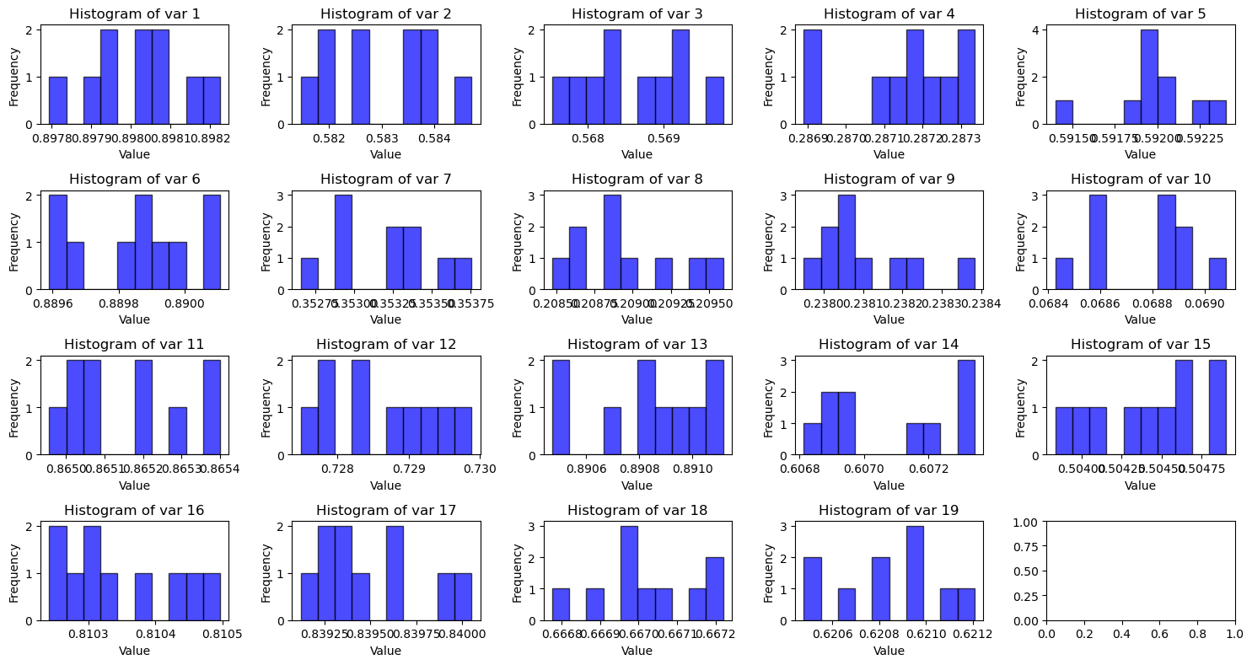
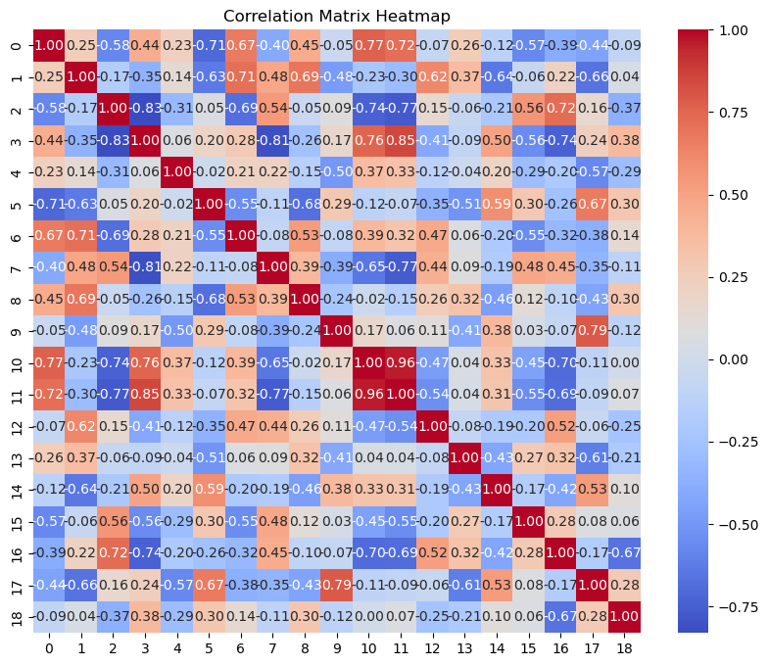
GA + L-BFGS-B return parameter sets
X best = [0.89822568 0.58375721 0.56752307 0.28733618 0.59190536 0.88966501 0.35375698 0.20869523 0.23823104 0.06890725 0.86540033 0.72964186 0.89093788 0.60733761 0.50450945 0.81033345 0.83931667 0.66696147 0.62083669]

Slide 22
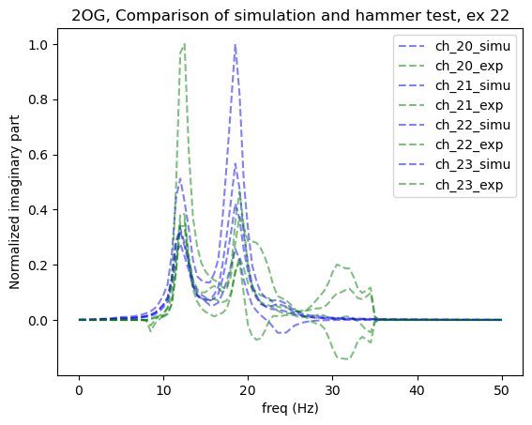
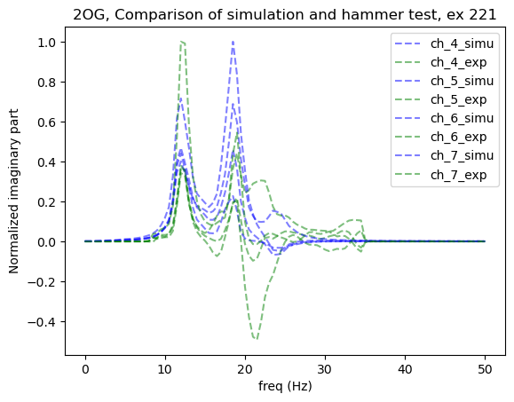
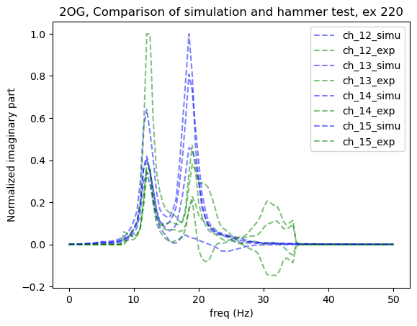
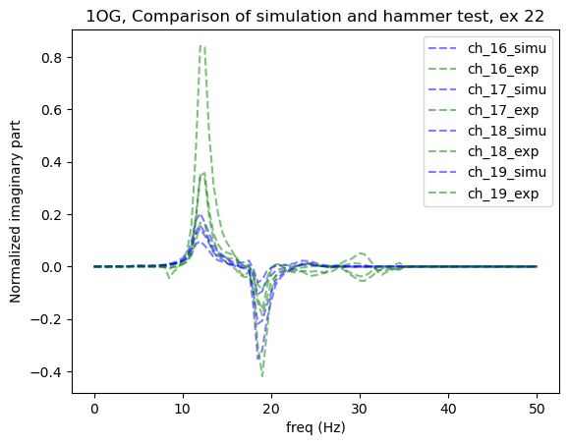
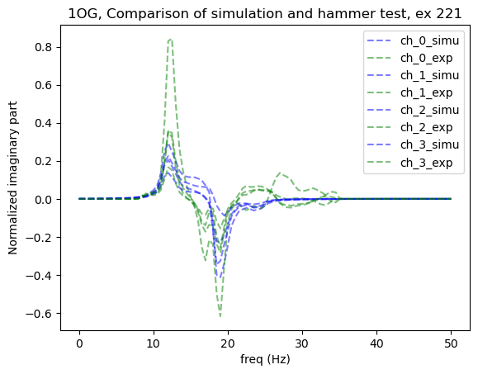
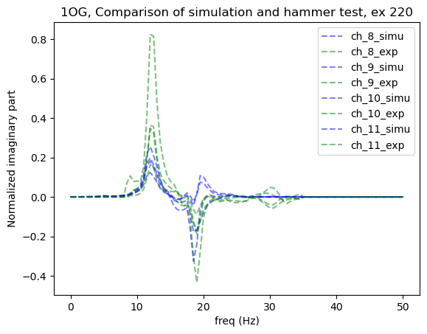
After FEM update

Slide 23
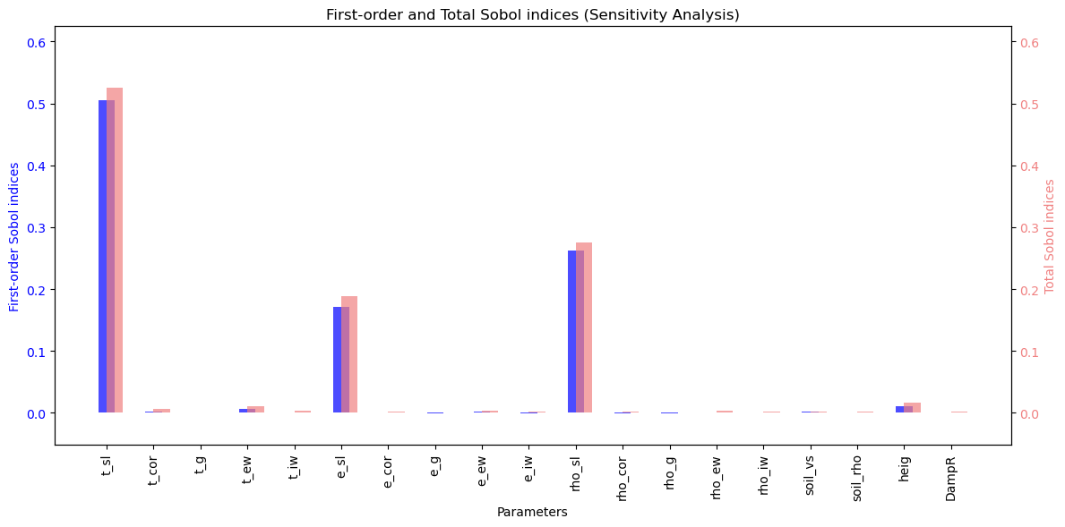
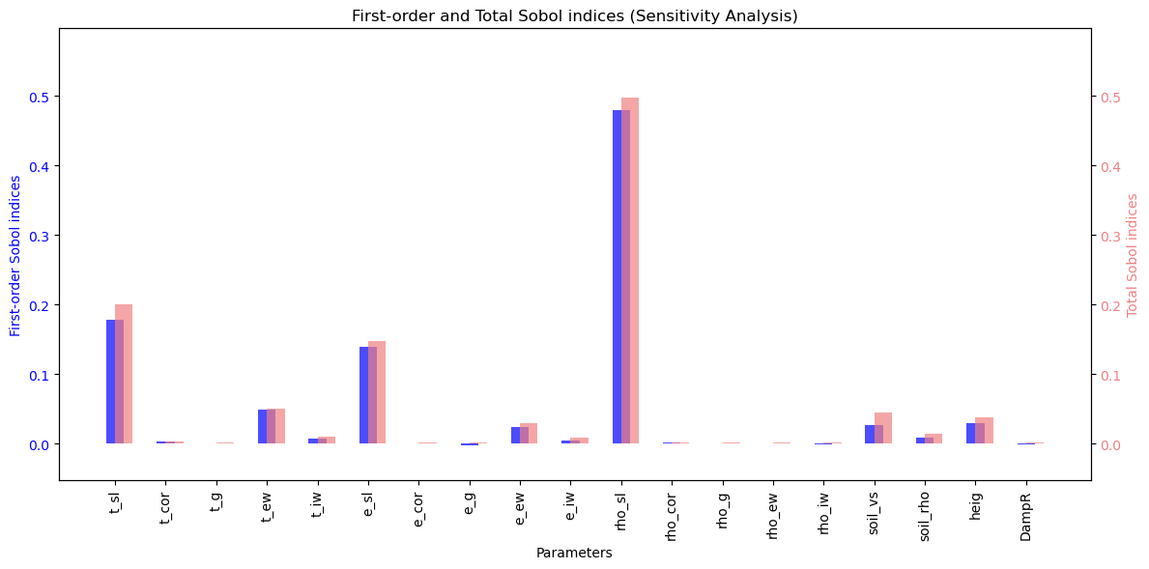
1st dominated peaks
GSA Sobol’s indices
Based on GPR surrogate model for natural frequencies
The most significant parameters are:
Thickness of the slab
Young’s modulus of slab
Density of the slab
Height of the building
Others are:
Thickness of the wall outside
Thickness of the wall inner
Young’s modulus of the wall outside
Soil velocity
Soil density
2nd dominated peaks

Slide 24
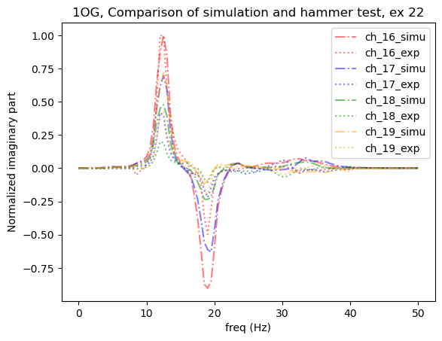
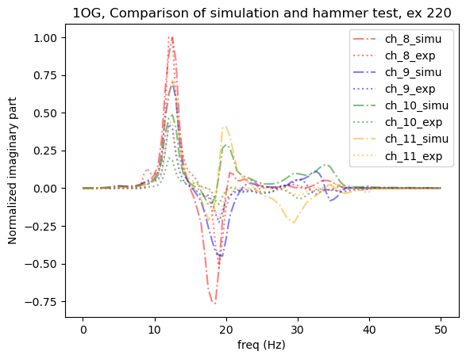
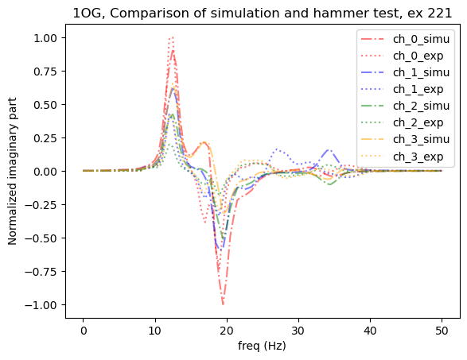
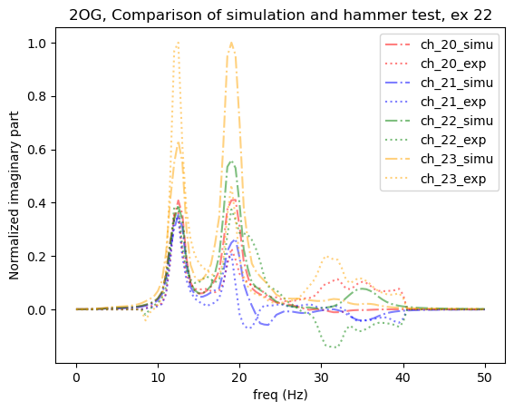
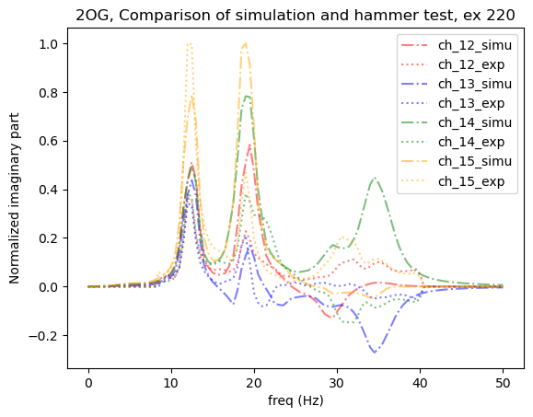
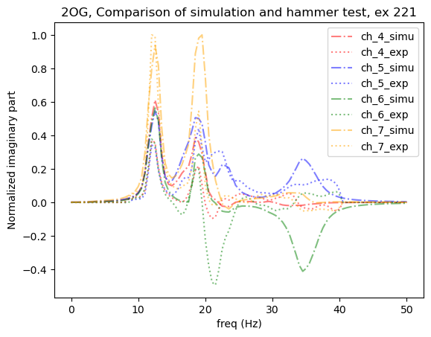
Only used top 9 significant parameters for FEMU
X_update = [0.84507014 ,0.5 0.5 ,0.50633148 ,0.1885995 ,0.75976072 ,0.5 ,0.5 ,0.21309783 ,0.5 ,0.66487426 ,0.5 ,0.5 ,0.5 ,0.5 ,0.35020139 ,0.35176575 ,0.54754628 ,0.5]

Slide 25
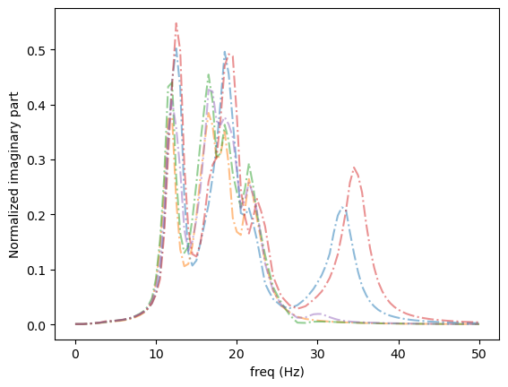
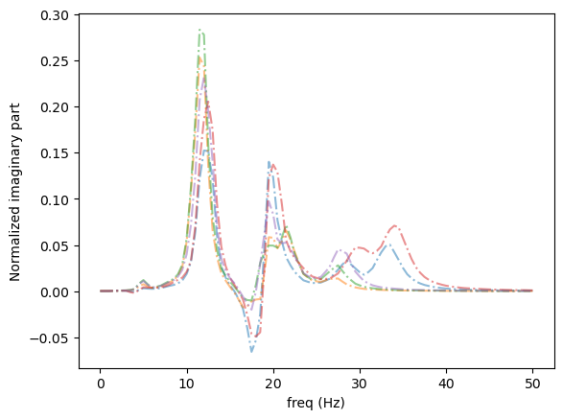
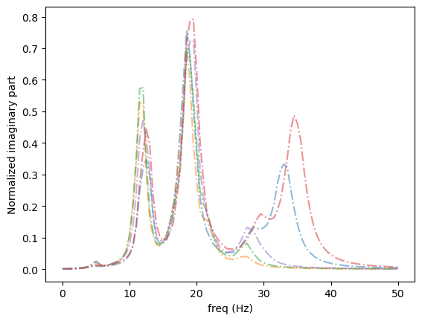
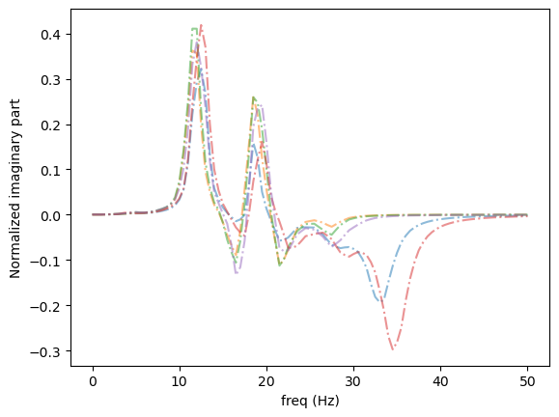
Changing low significant parameters
Mode shapes change when insignificant parameters change.
Fixing the significant parameters for determining peaks.
Only changing the insignificant parameters from GSA.
The location of peaks are not changed.
The mode shapes at non-dominated peaks are changing.

Slide 26
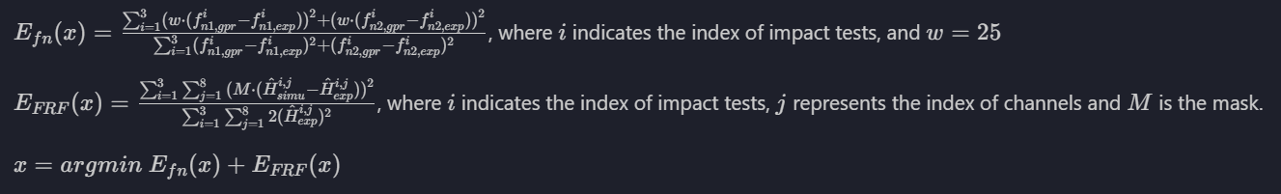
Extended FEMU if FRFs are available
Observation:
Optimized the parameters by fitting FRFs from simulation and hammer testing.
The significant parameters from GSA control the location of the peaks.
The insignificant parameter from GSA could be used for modifying the mode shapes except the dominated frequencies.
Proposal for extended FEMU:
Using GP optimizer to fit the FRFs from simulation and hammer testing from 24 existed channels.
The objective function requires running the simulation 3 times, which is time-consuming.
Applying mask to amplify the significant of FRF’s amplitude in certain range.

Slide 27


After Extended FEM update
FEMU

Slide 28




After Extended FEM update
Notes:
x = [0.84507014, 0.13539517760383665, 1.0, 0.50633148, 0.1885995, 0.75976072, 1.0, 1.0, 0.21309783, 0.5004223475169194, 0.66487426, 0.7993062197679878, 0.6071382305792775, 0.23569906134107818, 0.9707206995435914, 0.35020139, 0.35176575, 0.54754628, 0.0]

Slide 29
Current issues
Focus only on the first and second-dominated frequencies.
-> The scaling between FRFs from simulation and hammer testing can not be considered.
->If there is any other peak appears, its effect will not be considered.
This method cannot find the global minimum; the result will converge but will be different all the time if the random seed is not fixed. However, it should report a potential range of each parameter.

Slide 30
Sensitivity based FEMU:
Not working, due to an underdetermined system
[1]: Improved finite element model updating of a fullscale steel bridge using sensitivity analysis
[2]: The sensitivity method in finite element model updating: A tutorial

Slide 31


GSA Sobol’s indices based on GPR surrogate model for natural frequency

Slide 32


GSA Sobol’s indices based on GPR surrogate model for natural frequency

Slide 33



















X = [0.84507014 0.5 0.5 0.50633148 0.1885995 0.75976072 0.5 0.5 0.21309783 0.5 0.66487426 0.5 0.5 0.5 0.5 0.35020139 0.35176575 0.54754628 0.5 ]

Slide 34
https://www.uml.edu/docs/s-v-jan2001_modal_analysis_tcm18-189939.pdf EXPERIMENTAL MODAL ANALYSIS Updating Finite Element Model of a Wind Turbine Blade Section Using Experimental Modal Analysis Results

